Slide 1
Web Interface part 4
Complied by -- Ms. Rushita Verlekar
BCA

Slide 2
Topics
Styling for color, background, font, text etc.
Pseudoclass & CSS pseudo-element
Div & span –align, positioning, float
CSS MODEL
CSS image, list, table
Opacity
Color codes gradient
Media types and CSS media queries

Slide 3
Color and Background
CSS properties to apply colors and background colors to your websites
Property | Valid Values | Sample Usage
color | Color value | {color:green;}
background-color | Color value | {background-color:green;}
background-image | url | none | {background-image: url(apple.jpg);}
background-repeat | repeat | no-repeat | {background-repeat: no-repeat;}
background-attachment | scroll | fixed | {background-attachment: fixed;}
background-position | [top | center | bottom | left | center | right] | {background-position: top center;}
background | color || url || repeat || scroll || position | { background:red url(apple.jpg) ;}

Slide 4
Example - Color & Background
HTML code
<html>
<head>
<title>CSS Example</title>
<link rel="stylesheet" type="text/css" href="style.css" />
</head>
<body >
<H1> India Tourism </H1>
<h2> If there is Heaven on earth its here, its here, its here.</h2>
</body>
</html>
Style.css
body {
background-color: #FFCC66;
background-image: url("scene.jpg");
background-repeat: no-repeat;
background-attachment: fixed;
background-position: center right;
}
h1 {
color: #990000;
background-color: #FC9804;
}

Slide 5
CSS Properties for Fonts
Property | Valid Values | Sample Usage
font-family | Arial. San-Serif, times, Times New Roman etc… | {font-family: Arial,times;}
font-style | normal, italic, oblique | {font-style: italic;}
font-variant | Normal, small caps | {font-variant: small-caps;}
font-weight | Normal, bold | {font-weight: bold;}
font-size | Size either absolute value or relative | {font-size: 12pt;}
font | [font || font-variant|| font-weight || font-size] font-family | {font: bold 12pt Arial ;}

Slide 6
Example - Font
HTML code
<html> <head><title>CSS Example</title>
<link rel="stylesheet" type="text/css" ref="style.css" />
</head> <body>
<H1> Thought of the Day </H1>
<H3 > NO ONE CAN GO BACK AND CHANGE A BAD BEGINNING, <br/> BUT ANYONE CAN START NOW AND CREATE A SUCCESFUL ENDING
</font> </H3>
</body> </html>
H3 Style.css
{
font-family: "Times New Roman", Times, serif;
color: red;
text-align: center;
}

Slide 7
CSS Properties for Text
Formatting and adding style to text is achieved through text properties.
Property | Valid Values | Sample Usage
text-indent | Length | percentage | {text-indent:25px;}
text-align | Left | right | center | justify | {text-align: center;}
text-decoration | None | underline | overline | line-through | {text-decoration: underline;}
letter-spacing | Normal | length | {letter-spacing: 4pt;}
text-transform | Capitalize | uppercase | lowercase | none | {text-transform: uppercase;}

Slide 8
CSS Properties for Borders
Borders can be used as a decorative element or to underline a separation of two or more elements.
Property | Valid Values | Sample Usage
border-width | Length | percentage | [medium | thick | thin] | {border-width: thick;}
border-color | Color values | {border-color: gold;}
border-style | dashed | dotted | groove | inset | outset | ridge | solid | none | {border-style: dotted ;}
border | width || style || color | {border: 1px solid blue;}

Slide 9
Example - Borders
HTML code
<html><head><title>CSS Example</title>
<link rel="stylesheet" type="text/css" href="style1.css" />
</head> <body > <H1> The Art of Being Well </H1>
<H2> Negative people do not find solutions and they enlarge problems. It is better to light <br/> a match than to curse the darkness. We are what we think.</H2>
<H3> Some rules for happier life:
<ul>
<li> Accept </li>
<li> Make Decisions </li>
<li> Find Solutions </li>
<li> Dont live by appearances </li>
<li> Trust </li>
</ul>
</h3> </body> </html>

Slide 10
Example – Borders...
Style1.css
h1 {
border-width: thick;
border-style: double;
border-color: gold;
}
h2 {
border-width: 20px;
border-style: outset ;
border-color: red;
}
p {
border-width: 1px;
border-style: dashed;
border-color: blue;
}
ul {
border-width: thin;
border-style: solid;
border-color: orange;
}

Slide 11
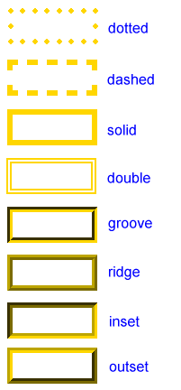
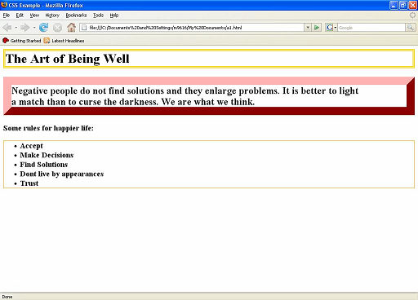
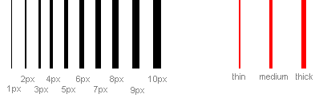
Borders…

Slide 12
Height and Width
Defines the height and width of an element.
Property | Valid Values | Sample Usage
height | Length | percentage | auto | {height: 200px;}
width | Length | percentage | auto | {width: 400px;}
CSS example
ul
{
height: auto;
width: 200px;
border: 1px solid black;
background: orange;
}

Slide 13
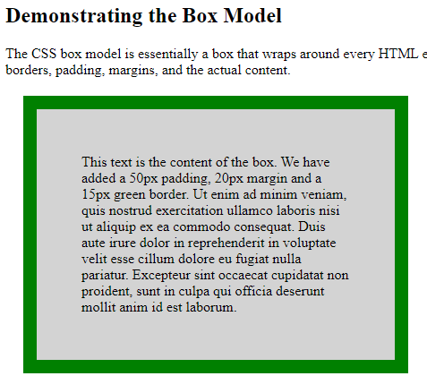
Example for box model
<!DOCTYPE html> <html><head> <style>
div {
background-color: lightgrey;
width: 300px;
border: 15px solid green;
padding: 50px;
margin: 20px;
}
</style></head> <body>
<h2>Demonstrating the Box Model</h2>
<p>The CSS box model is essentially a box that wraps around every HTML element. It consists of: borders, padding, margins, and the actual content.</p>
<div>This text is the content of the box. We have added a 50px padding, 20px margin and a 15px green border. Ut enim ad minim veniam, quis nostrud exercitation ullamco laboris nisi ut aliquip ex ea commodo consequat. Duis aute irure dolor in reprehenderit in voluptate velit esse cillum dolore eu fugiat nulla pariatur. Excepteur sint occaecat cupidatat non proident, sunt in culpa qui officia deserunt mollit anim id est laborum.</div>
</body> </html>

Slide 14
CSS Layout - float
The float property is used for positioning and formatting content e.g. let an image float left to the text in a container.
The float property can have one of the following values:
left - The element floats to the left of its container
right - The element floats to the right of its container
none - The element does not float (will be displayed just where it occurs in the text). This is default
<!DOCTYPE html> <html>
<head> <style>
img {
float: right;
}
</style> </head><body>
<img src="pineapple.jpg" alt="Pineapple" style="width:170px;height:170px;margin-left:15px;">
text text text text text text text text text …..
…..
</body>
</html>

Slide 15
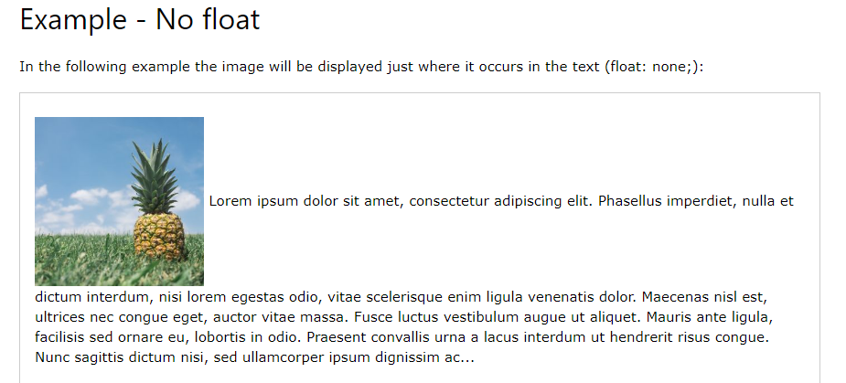
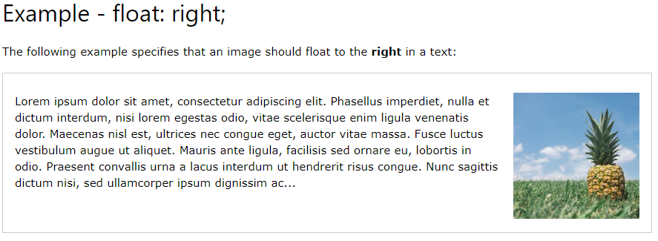
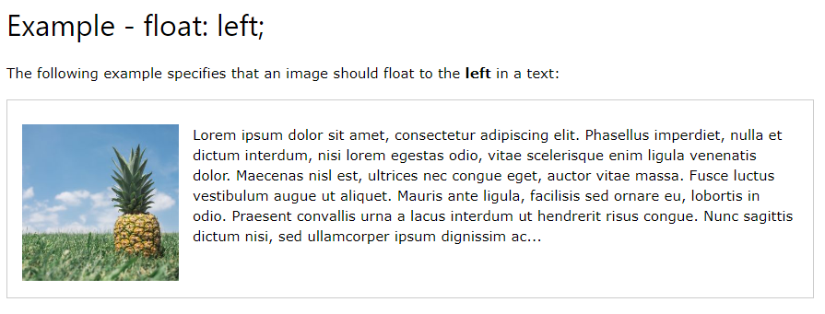
Example of Float

Slide 16
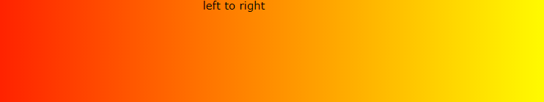
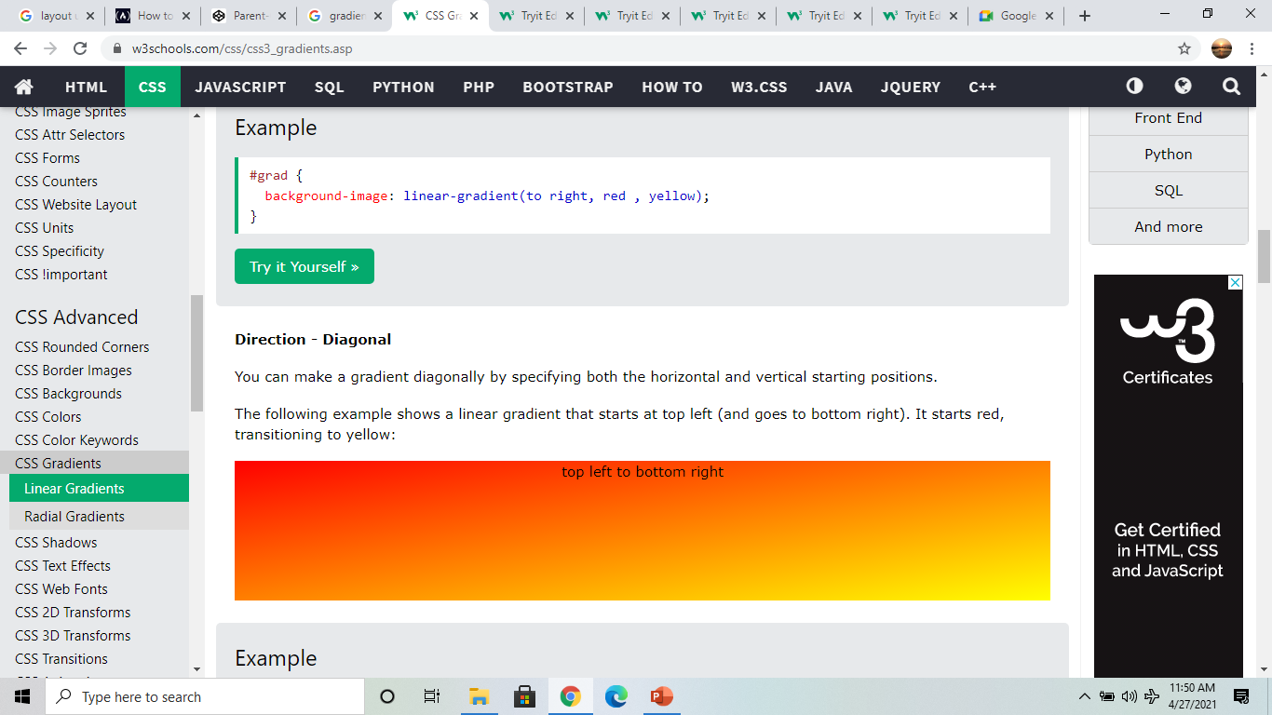
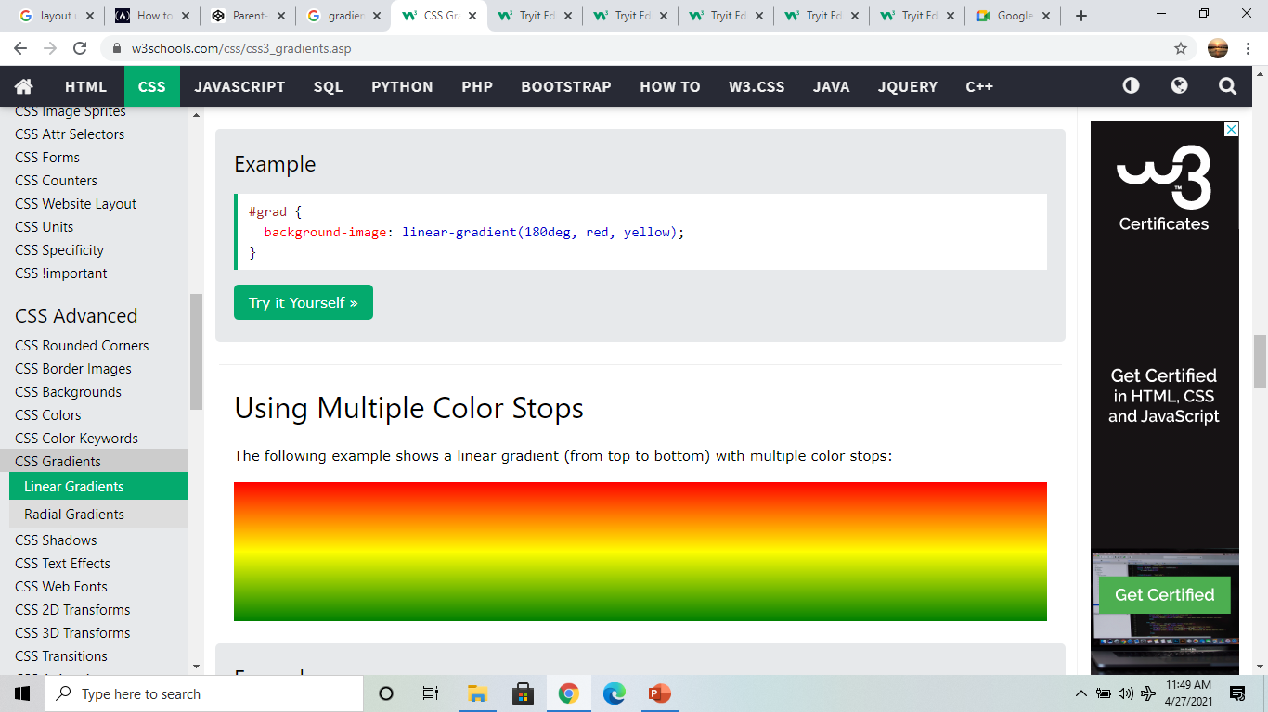
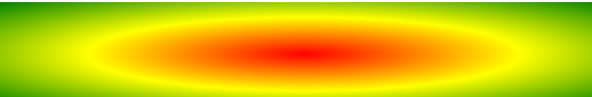
CSS Gradients
CSS gradients let you display smooth transitions between two or more specified colors.
CSS defines two types of gradients:
Linear Gradients (goes down/up/left/right/diagonally)
Radial Gradients (defined by their center)
Direction - Left to Right
#grad { background-image: linear-gradient(to right, red , yellow); }
Direction – Diagonal
#grad { background-image: linear-gradient(to bottom right, red, yellow); }
Using Multiple Color Stops
#grad { background-image: linear-gradient(red, yellow, green); }
Using radial-gradient
#grad { background-image: radial-gradient(red, yellow, green); }

Slide 17

Example of Gradient
<!DOCTYPE html>
<html>
<head>
<style>
#grad1 {
height: 200px;
background-color: red; /* For browsers that do not support gradients */
background-image: linear-gradient(red, yellow);
}
</style>
</head>
<body>
<h1>Linear Gradient - Top to Bottom</h1>
<p>This linear gradient starts red at the top, transitioning to yellow at the bottom:</p>
<div id="grad1"></div>
</body>
</html>

Slide 18
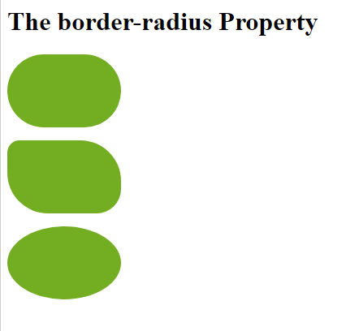
CSS Rounded Corners
<!DOCTYPE html> <html><head><style>
#rcorners1 {
border-radius: 50px;
background: #73AD21;
padding: 20px;
width: 100px;
height: 50px;
}
#rcorners2 {
border-radius: 15px 50px 30px;
background: #73AD21;
padding: 20px;
width: 100px;
height: 50px;
}
#rcorners3 {
border-radius: 50%;
background: #73AD21;
padding: 20px;
width: 100px;
height: 50px;
}
</style> </head>
<body>
<h1>The border-radius Property</h1>
<p id="rcorners1"></p>
<p id="rcorners2"></p>
<p id="rcorners3"></p>
</body>
</html>

Slide 19
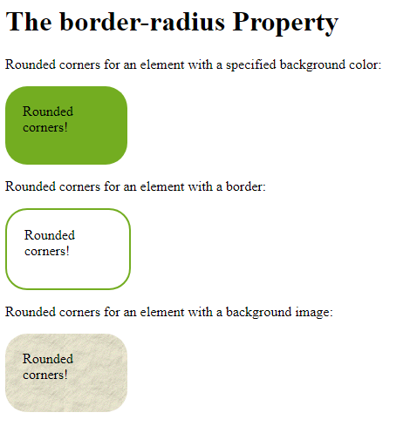
#rcorners1 {
border-radius: 25px;
background: #73AD21;
padding: 20px;
width: 100px;
height: 50px;
}
#rcorners2 {
border-radius: 25px;
border: 2px solid #73AD21;
padding: 20px;
width: 100px;
height: 50px;
}
#rcorners3 {
border-radius: 25px;
background: url(paper.gif);
background-position: left top;
background-repeat: repeat;
padding: 20px;
width: 100px;
height: 50px;
}

Slide 20
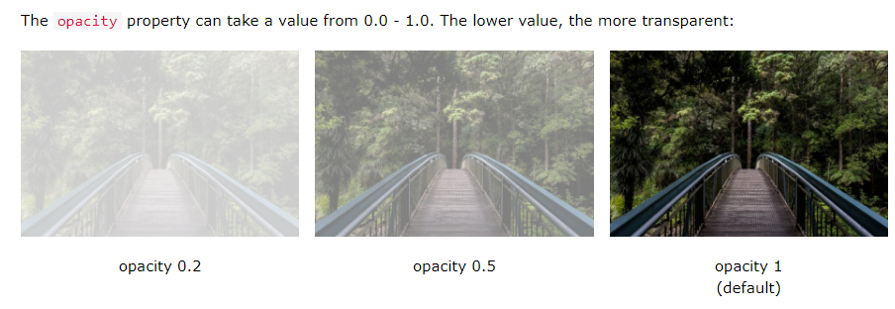
Using CSS Opacity / Transparency
CSS gradients also support transparency, which can be used to create fading effects.
To add transparency, we use the rgba() function to define the color stops. The last parameter in the rgba() function can be a value from 0 to 1, and it defines the transparency of the color: 0 indicates full transparency, 1 indicates full color (no transparency).

Slide 21
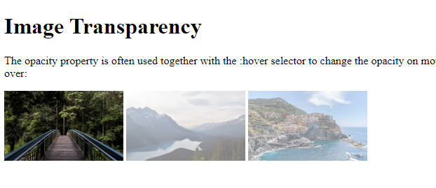
Example on transparency change on mouse hower.
<!DOCTYPE html> <html><head><style>
img {
opacity: 0.5;
}
img:hover {
opacity: 1.0;
}
</style> </head> <body>
<h1>Image Transparency</h1>
<p>The opacity property is often used together with the :hover selector to change the opacity on mouse-over:</p>
<img src="img_forest.jpg" alt="Forest" width="170" height="100">
<img src="img_mountains.jpg" alt="Mountains" width="170" height="100">
<img src="img_5terre.jpg" alt="Italy" width="170" height="100">
</body> </html>
Notes:
Refer more image css properties : https://www.w3schools.com/css/css3_images.asp

Slide 22
CSS Media types & Media Queries
Media Types : @media rule, introduced in CSS2, made it possible to define different style rules for different media types.Examples: You could have one set of style rules for computer screens, one for printers, one for handheld devices, one for television-type devices, and so on.
<style tyle = "text/css">
<!--
@media print {
body { font-size: 10pt }
}
@media screen {
body { font-size: 12pt }
}
@media screen, print {
body { line-height: 1.2 }
}
-->
</style>

Slide 23
CSS Media Queries
Media queries in CSS3 extended the CSS2 media types idea: Instead of looking for a type of device, they look at the capability of the device.
Media queries can be used to check many things, such as:
width and height of the viewport
width and height of the device
orientation (is the tablet/phone in landscape or portrait mode?)
resolution
Using media queries are a popular technique for delivering a tailored style sheet to desktops, laptops, tablets, and mobile phones (such as iPhone and Android phones).

Slide 24
Example 1
<!DOCTYPE html> <html> <head> <style>
body {
background-color: tan;
color: black;
}
/* On screens that are 992px wide or less, the background color is blue */
@media screen and (max-width: 992px) {
body {
background-color: blue;
color: white;
}
}
/* On screens that are 600px wide or less, the background color is olive */
@media screen and (max-width: 600px) {
body {
background-color: olive;
color: white;
}
}
</style>
</head>
<body>
<h1>Resize the browser window to see the effect!</h1>
<p>By default, the background color of the document is "tan". If the screen size is 992px or less, the color will change to "blue". If it is 600px or less, it will change to "olive".</p>
</body>
</html>

Slide 25
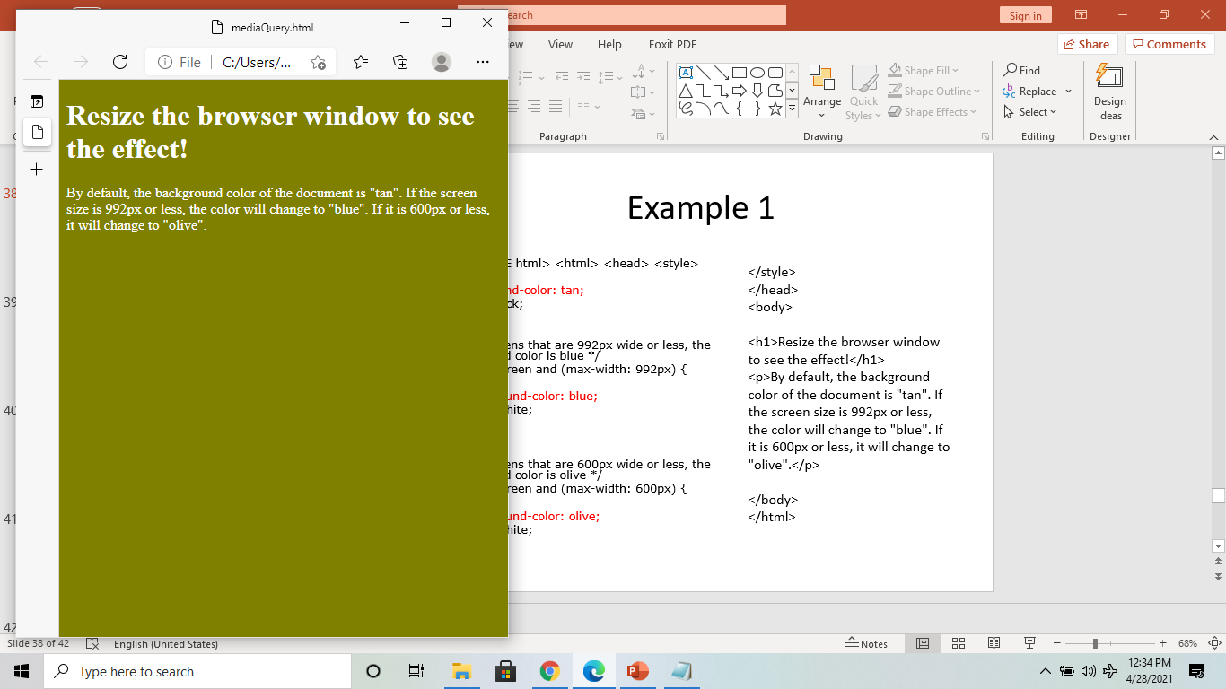
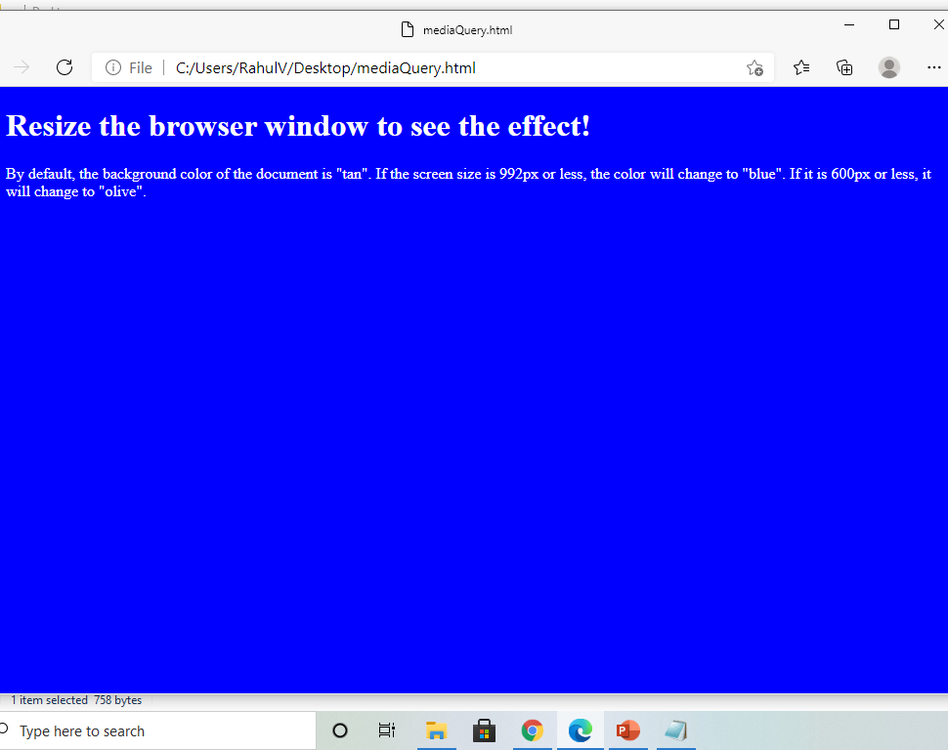
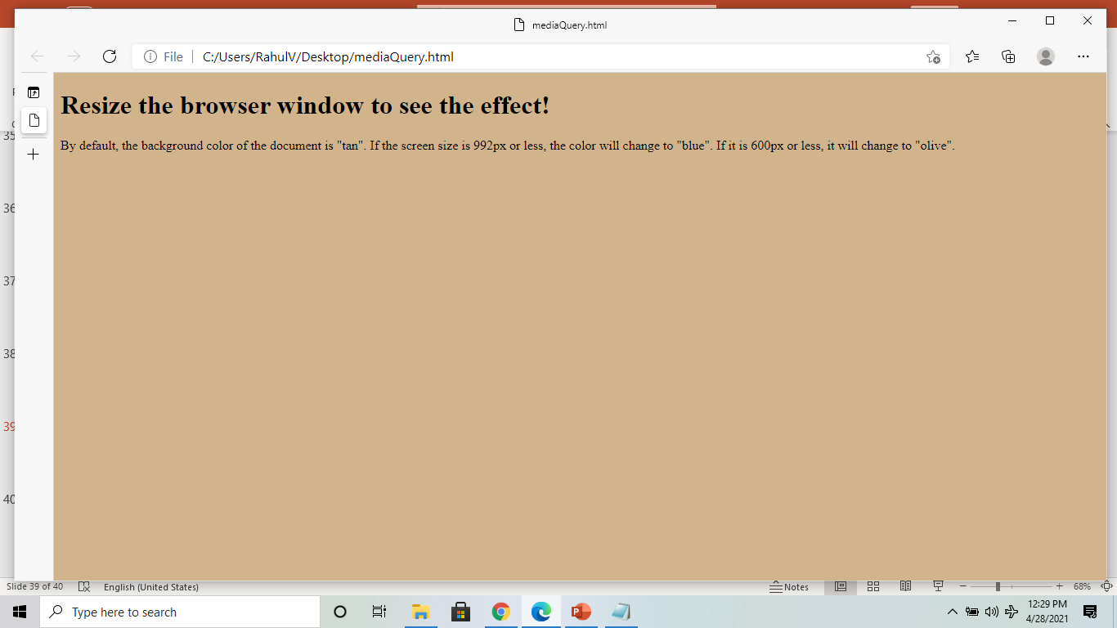
As you resize the color changes

Slide 26
Example 2
</style>
</head>
<body>
<h2>Change the appearance of DIV on different screen sizes</h2>
<div class="example">Example DIV.</div>
<p>When the browser's width is between 600 and 900px OR above 1100px, change the appearance of DIV.
<strong>Resize the browser window to see the effect</strong>.</p>
</body>
</html>
<!DOCTYPE html>
<html>
<head>
<meta name="viewport" content="width=device-width, initial-scale=1">
<style>
@media screen and (max-width: 900px) and (min-width: 600px), (min-width: 1100px) {
div.example{
font-size: 50px;
padding: 50px;
border: 8px solid black;
background: yellow;
} }

Slide 27
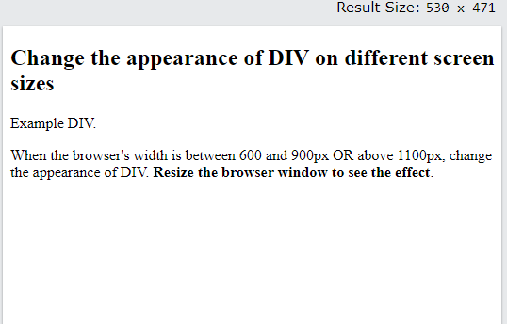
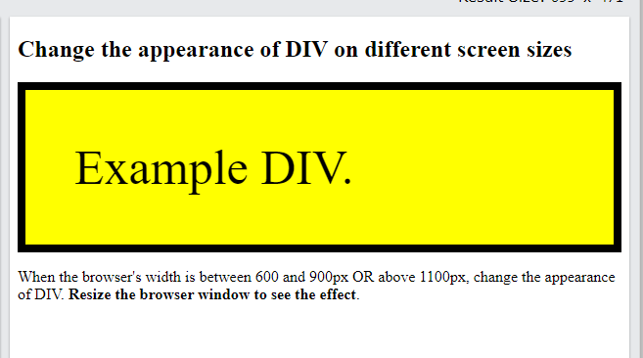
Click on the below links for example
https://www.w3schools.com/css/tryit.asp?filename=trycss3_media_queries2

